Slide 1
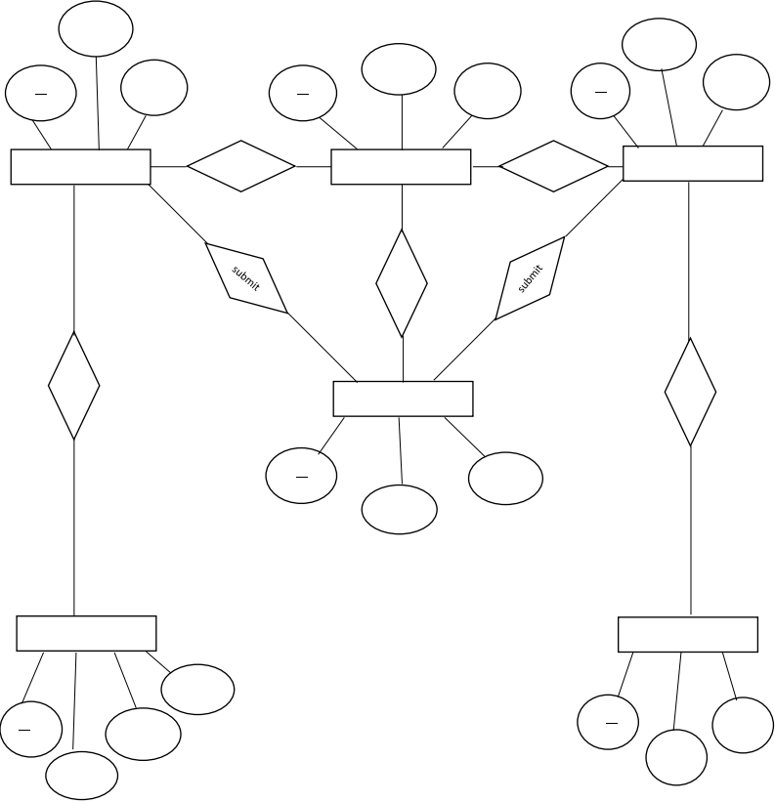
E R DIAGRAM
CODEWORK FREELANCER MANAGEMENT SYTEM
email
email
pass
email
pass
id
pass
id
id
CLIENT
M
has
1
ADMINE
1
has
M
FREELANCER
1
1
1
1
1
view
Post
M
M
M
send
FEEDBACK
id
msg
name
M
M
POST PROJECT
REQUEST PROJECT
desc
id
name
id
fid
price
pid
1

